Slide 1
Programming distributed memory systems
Clusters
Distributed computers
ITCS 4/5145 Parallel Computing, UNC-Charlotte, B. Wilkinson, Jan 6, 2015.

Slide 2
Computer Cluster
Complete computers connected together through an interconnection network, often Ethernet switch.
Memory of each computer not directly accessible from other computers (distributed memory system)
Example cci-gridgw.uncc.edu cluster
Master node
Switch
Switch
Compute nodes
Programing model – separate processes running on each system communicating through explicit messages to exchange data and synchronization.

Slide 3
MPI (Message Passing Interface)
Widely adopted message passing library standard. MPI-1 finalized in 1994, MPI-2 in 1996, MPI-3 in 2012
Process-based -- processes communicate between themselves with messages. Point-to-point and collectively.
A specification, not an implementation.
Several free implementations exist, OpenMPI, MPICH,
Large number of routines: MPI-1 128 routines, MPI-2 287 routines, MPI-3 440+ routines, but typically only a few used.
C and Fortran bindings (C++ removed from MPI-3)
Originally for distributed systems but now used for all types, clusters, shared memory, hybrid.

Slide 4
Some common MPI Routines
We will look into the use of these routines shortly
Environment
MPI_Init() - Initialize MPI (No MPI routines before this)
MPI_Comm_size() - Get number of processes
(in a communicating domain)
MPI_Comm_rank() - Get process ID (rank)
MPI_Finalize() - Terminate MPI (No MPI routines after this)
Pont-to-point message passing
MPI_Send() - Send a message, locally blocking
MPI_Recv() - Receive a message, locally blocking
MPI_SSend() - Send a message, synchronous
MPI_Isend() - Send a message, non blocking
Collective message passing
MPI_Gather() - All to one, collect elements of an array
MPI_Scatter() - One to all, send elements of array
MPI_Reduce() - Collective computation (sum,min,max, …)
MPI_Barrier() - Synchronize processes

Slide 5
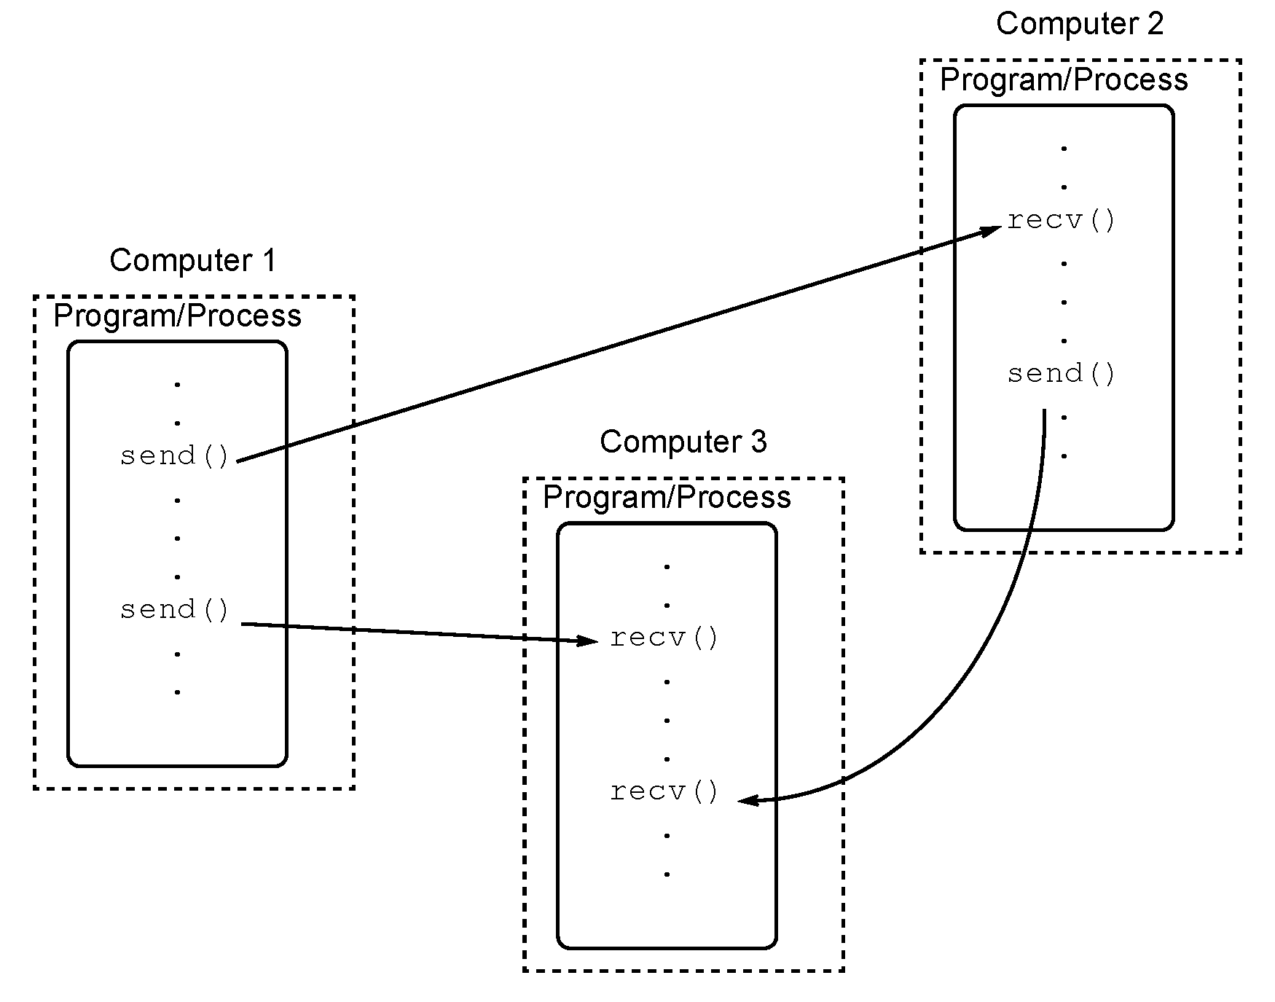
Message passing concept using library routines
Note each computer executes its own program

Slide 6
1. Multiple program, multiple data (MPMD) model
Creating processes for execution on different computers
Different programs executed by each processor
Source
Source
fi
le
fi
le
Compile to suit
processor
Executable
Possible in MPI but for many application different programs not needed.
Processor 0
Processor
p
- 1

Slide 7
2. Single Program Multiple Data (SPMD) model
Same program executed by each processor
Control statements select different parts for each processor to execute.
Source
fi
le
Compile to suit
processor
Ex
ecutab
les
Usual MPI way
Processor 0
Processor
p
-
1

Slide 8
Static process creation: All executables started together.
Dynamic process creation: Processes created from within an executing process (fork)
Starting processes
Static process creation the normal MPI way.
Possible to dynamically start processes from within an executing process (fork) in MPI-2, which might find applicability if do not initially how many processes needed.

Slide 9
MPI program structure
Takes command line arguments, which includes the number of processes to use, see later.
int main(int argc, char **argv) {
MPI_Init(&argc, &argv);
// Code executed by all processes
MPI_Finalize();
}

Slide 10
In MPI, processes within a defined “communicating group” given a number called a rank starting from zero onwards.
Program uses control constructs, typically IF statements, to direct processes to perform specific actions.
Example
if (rank == 0) ... /* do this */;
if (rank == 1) ... /* do this */;
.
.
.

Slide 11
Master-Slave approach
Usually computation constructed as a master-slave model
One process (the master), performs one set of actions and all the other processes (the slaves) perform identical actions although on different data, i.e.
if (rank == 0) ... /* master do this */;
else ... /* all slaves do this */;

Slide 12
MPI point-to-point message passing using MPI_send() and MPI_recv() library calls
To send a message, x, from a source process, 1, to a destination process, 2, and assign to y:
Process 1 with rank = 1
Process with rank = 2
int x
int y
MPI_send(&x, 2, … );
Movement of data
MPI_recv(&y, 1, … );
Destination rank
Source rank
Buffer holding data
Buffer holding data
Process 2 waits for a message from process 1

Slide 13
Semantics of MPI_Send() and MPI_Recv()
Called blocking, which means in MPI that routine waits until all its local actions within process have taken place before returning.
After returning, any local variables used can be altered without affecting message transfer but not before.
MPI_Send() – When returns, message may not reached its destination but process can continue in the knowledge that message safely on its way.
MPI_Recv() – Returns when message received and data collected. Will cause process to stall until message received.
Other versions of MPI_Send() and MPI_Recv() have different semantics.

Slide 14
Message Tag
Used to differentiate between different types of messages being sent.
Message tag is carried within message.
If special type matching is not required, a wild card message tag used. Then recv() will match with any send().

Slide 15
Message Tag Example
To send a message, x, from a source process, 1, with message tag 5 to a destination process, 2, and assign to y:
Process 1 with rank = 1
Process with rank = 2
int x
int y
MPI_send(&x, 2, …, 5, … );
Movement of data
MPI_recv(&y, 1, … ,5, … );
Tag
Source rank
Tag
Destination rank
Buffer holding data
Buffer holding data
Process 2 waits for a message from process 1 with a tag of 5

Slide 16
Unsafe message passing - Example
Process 0
Process 1
Destination
send(…,1,…);
lib()
send(…,1,…);
Source
(a) Intended beha
vior
recv(…,0,…);
lib()
recv(…,0,…);
Process 0
Process 1
send(…,1,…);
lib()
send(…,1,…);
(b) P
ossib
le beha
vior
recv(…,0,…);
lib()
recv(…,0,…);
Tags alone will not fix this as the same tag numbers might be used.

Slide 17
MPI Solution
“Communicators”
Defines a communication domain - a set of processes that are allowed to communicate between themselves.
Communication domains of libraries can be separated from that of a user program.
Used in all point-to-point and collective MPI message-passing communications.
Process rank is a “rank” in a particular communicator.
Note: Intracommunicator – for communicating within a single group of processes.
Intercommunicator - for communicating within two or more groups of processes

Slide 18
Default Communicator MPI_COMM_WORLD
Exists as first communicator for all processes existing in the application.
Process rank in MPI_COMM_World obtained from:
MPI_Comm_rank(MPI_COMM_WORLD,&myrank);
A set of MPI routines exists for forming additional communicators although we will not use them.

Slide 19
Parameters of blocking send
MPI_Send(buf, count, datatype, dest, tag, comm)
Datatype of each item
Message tag
Address of send buffer
Number of items to send
Communicator
Notice a pointer
Rank of destination process
Parameters of blocking receive
MPI_Recv(buf, count, datatype, src, tag, comm, status)
Datatype of each item
Message tag
Address of receive buffer
Maximum number of items to receive
Communicator
Rank of source process
Status after operation
In our code we do not check status but good programming practice to do so.
Usually send and recv counts are the same.

Slide 20
MPI Datatypes
(defined in mpi.h)
MPI datatypes
MPI_BYTE
MPI_PACKED
MPI_CHAR
MPI_SHORT
MPI_INT
MPI_LONG
MPI_FLOAT
MPI_DOUBLE
MPI_LONG_DOUBLE
MPI_UNSIGNED_CHAR
Slide from C. Ferner, UNC-W

Slide 21
Wide cards -- any source or tag
In MPI_Recv(), source can be MPI_ANY_SOURCE and tag can be MPI_ANY_TAG
Cause MPI_Recv() to take any message destined for current process regardless of source and/or tag.
Example
MPI_Recv(message,256,MPI_CHAR, MPI_ANY_SOURCE, MPI_ANY_TAG,MPI_COMM_WORLD, &status);

Slide 22
Program Examples
To send an integer x from process 0 to process 1 and assign to y.
int x, y; //all processes have their own copies of x and y
MPI_Comm_rank(MPI_COMM_WORLD,&myrank); // find rank
if (myrank == 0) {
MPI_Send(&x,1,MPI_INT,1,msgtag, MPI_COMM_WORLD);
} else if (myrank == 1) {
MPI_Recv(&y,1,MPI_INT,0,msgtag,MPI_COMM_WORLD,status);
}

Slide 23
Another version
To send an integer x from process 0 to process 1 and assign to y.
MPI_Comm_rank(MPI_COMM_WORLD,&myrank); // find rank
if (myrank == 0) {
int x;
MPI_Send(&x,1,MPI_INT,1,msgtag, MPI_COMM_WORLD);
} else if (myrank == 1) {
int y;
MPI_Recv(&y,1,MPI_INT,0,msgtag,MPI_COMM_WORLD,status);
}
What is the difference?

Slide 24
Sample MPI Hello World program
#include <stddef.h>
#include <stdlib.h>
#include "mpi.h"
main(int argc, char **argv ) {
char message[20];
int i,rank, size, type=99;
MPI_Status status;
MPI_Init(&argc, &argv);
MPI_Comm_size(MPI_COMM_WORLD,&size);
MPI_Comm_rank(MPI_COMM_WORLD,&rank);
if(rank == 0) {
strcpy(message, "Hello, world");
for (i=1; i<size; i++)
MPI_Send(message,13,MPI_CHAR,i,type,MPI_COMM_WORLD);
} else
MPI_Recv(message,20,MPI_CHAR,0,type,MPI_COMM_WORLD,&status);
printf( "Message from process =%d : %.13s\n", rank,message);
MPI_Finalize();
}

Slide 25
Program sends message “Hello World” from master process (rank = 0) to each of the other processes (rank != 0). Then, all processes execute a println statement.
In MPI, standard output automatically redirected from remote computers to the user’s console (thankfully!) so final result on console will be
Message from process =1 : Hello, world
Message from process =0 : Hello, world
Message from process =2 : Hello, world
Message from process =3 : Hello, world
...
except that the order of messages might be different but is unlikely to be in ascending order of process ID; it will depend upon how the processes are scheduled.

Slide 26
Another Example (array)
int array[100];
… // rank 0 fills the array with data
if (rank == 0)
MPI_Send (array, 100, MPI_INT, 1, 0, MPI_COMM_WORLD);
else if (rank == 1)
MPI_Recv(array, 100, MPI_INT, 0, 0, MPI_COMM_WORLD, &status);
tag
Destination
Source
Number of Elements
Slide based upon slide from C. Ferner, UNC-W

Slide 27
Another Example (Ring)
Each process (excepts the master) receives a token from the process with rank 1 less than its own rank.
Then each process increments the token by 2 and sends it to the next process (with rank 1 more than its own).
The last process sends the token to the master
0
1
7
2
6
3
5
4
Question: Do we have pattern for this?
Slide based upon slides from C. Ferner, UNC-W

Slide 28
Ring Example
#include <stdio.h>
#include <mpi.h>
int main (int argc, char *argv[]) {
int token, NP, myrank;
MPI_Status status;
MPI_Init (&argc, &argv);
MPI_Comm_size(MPI_COMM_WORLD, &NP);
MPI_Comm_rank(MPI_COMM_WORLD, &myrank);

Slide 29
Ring Example continued
if (myrank == 0) {
token = -1; // Master sets initial value before sending.
else {
// Everyone except master receives from process 1 less
// than its own rank.
MPI_Recv(&token, 1, MPI_INT, myrank - 1, 0,
MPI_COMM_WORLD, &status);
printf("Process %d received token %d from process %d\n",
myrank, token, myrank - 1);
}

Slide 30
Ring Example continued
// all processes
token += 2; // add 2 to token before sending it
MPI_Send(&token, 1, MPI_INT, (myrank + 1) % NP, 0,
MPI_COMM_WORLD);
// Now process 0 can receive from the last process.
if (myrank == 0) {
MPI_Recv(&token, 1, MPI_INT, NP - 1, 0,
MPI_COMM_WORLD, &status);
printf("Process %d received token %d from process %d\n",
myrank, token, NP - 1);
}
MPI_Finalize();
}

Slide 31
Results (Ring)
Process 1 received token 1 from process 0
Process 2 received token 3 from process 1
Process 3 received token 5 from process 2
Process 4 received token 7 from process 3
Process 5 received token 9 from process 4
Process 6 received token 11 from process 5
Process 7 received token 13 from process 6
Process 0 received token 15 from process 7

Slide 32
Matching up sends and recvs
Notice in code how you have to be very careful matching up send’s and recv’s.
Every send must have matching recv.
The sends return after local actions complete but the recv will wait for the message so easy to get deadlock if written wrong
Pre-implemented patterns are designed to avoid deadlock. We will look at deadlock again

Slide 33
Measuring Execution Time
MPI provides the routine MPI_Wtime() for returning time (in seconds) from some point in the past.
To measure execution time between point L1 and point L2 in code, might have construction such as:
double start_time, end_time, exe_time;
L1: start_time = MPI_Wtime(); // record time
.
.
L2: end_time = MPI_Wtime(); // record time
exe_time = end_time - start_time;
.

Slide 34
Using C time routines
To measure execution time between point L1 and point L2 in code, might have construction such as:
.
L1: time(&t1); // record time
.
.
L2: time(&t2); // record time
.
elapsed_Time = difftime(t2, t1); /*time=t2-t1*/
printf(“Elapsed time=%5.2f secs”,elapsed_Time);

Slide 35
gettimeofday()
#include <sys/time.h>
double elapsed_time;
struct timeval tv1, tv2;
gettimeofday(&tv1, NULL);
…
gettimeofday(&tv2, NULL);
elapsed_time = (tv2.tv_sec - tv1.tv_sec) +
((tv2.tv_usec - tv1.tv_usec) / 1000000.0);
Measure time to execute this section
Using time() or gettimeofday() routines may be useful if you want to compare with a sequential C version of the program with same libraries.

Slide 36
Compiling and executing MPI programs on the command line
(without a scheduler)

Slide 37
Compiling/executing MPI program
MPI implementations provide scripts, mpicc and mpiexec for compiling and executing code (not part of original standard but now universal)
To compile MPI C programs:
mpicc -o prog prog.c
To execute MPI program:
mpiexec -n no_procs prog
mpicc uses the gcc compiler adding the MPI libraries so all options with the gcc can be used.
-o option to specify name of output file. Can be before or after program name. Many prefer after.
Notice number of processes determined at execution time, so same code can be run with different numbers of processes
A positive integer specifying number of processes

Slide 38
Executing program on multiple computers
Usually computers specified in a file containing names of computers and possibly number of processes that should run on each computer.
Then specify file with –machines option with mpiexec
(or –hostfile or –f options).
Implementation-specific algorithm selects computers from list to run user processes.
Typically MPI would cycle through list in round robin fashion.
If a machines file not specified, a default machines file used or it may be that program will only run on a single computer.

Slide 39
Executing program on UNCC cluster
On UNCC cci-gridgw.uncc.edu cluster, mpiexec command is mpiexec.hydra.
Internal compute nodes have names used just internally. For example, a machines file to use nodes 5, 7 and 8 and the front node of the cci-grid0x cluster would be:
cci-grid05
cci-grid07
cci-grid08
cci-gridgw.uncc.edu
Then:
mpiexec.hydra -machinefile machines -n 4 ./prog
would run prog with four processes, one on cci-grid05, one on cci-grid07, one on cci-grid08, and one on cci-gridgw.uncc.edu.

Slide 40
Specifying number of processes to execute on each computer
Machines file can include how many processes to execute on each computer. For example:
# a comment
cci-grid05:2 # first 2 processes on 05
cci-grid07:3 # next 3 processes on 07
cci-grid08:4 # next 4 processes on 08
cci-gridgw.uncc.edu:1 # Last process on gridgw (09)
10 processes in total. Then:
mpiexec.hydra -machinefile machines -n 10 ./prog
If more processes were specified, they would be scheduled in round robin fashion.

Slide 41
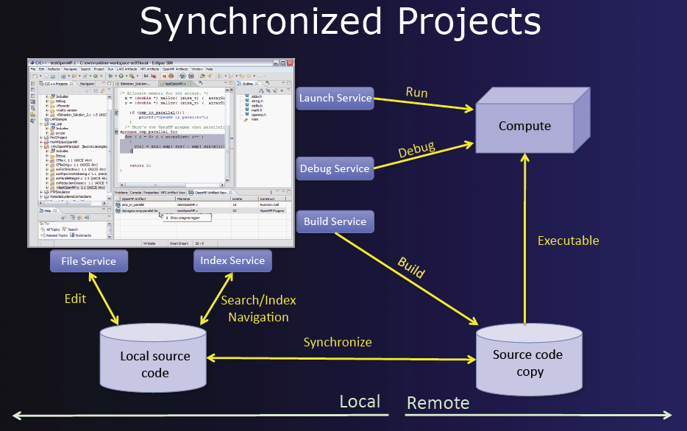
Eclipse IDE
PTP Parallel Tools Platform plug-in
Supports development of parallel programs (MPI, OpenMP).
Possible to edit and execute MPI program on client or a remote machine.
Eclipse-PTP installed on the course virtual machine.
Hope to explore Eclipse-PTP in assignments.
http://download.eclipse.org/tools/ptp/docs/ptp-sc11-slides-final.pdf

Slide 42
Visualization Tools
Programs can be watched as they are executed in a space-time diagram (or process-time diagram):
Process 1
Process 2
Process 3
Computing
Time
W
aiting
Message-passing system routine
Message
Visualization tools available for MPI, e.g., Upshot.

Slide 43
Questions

Slide 44
Next topic
More on MPI

